Slide 1
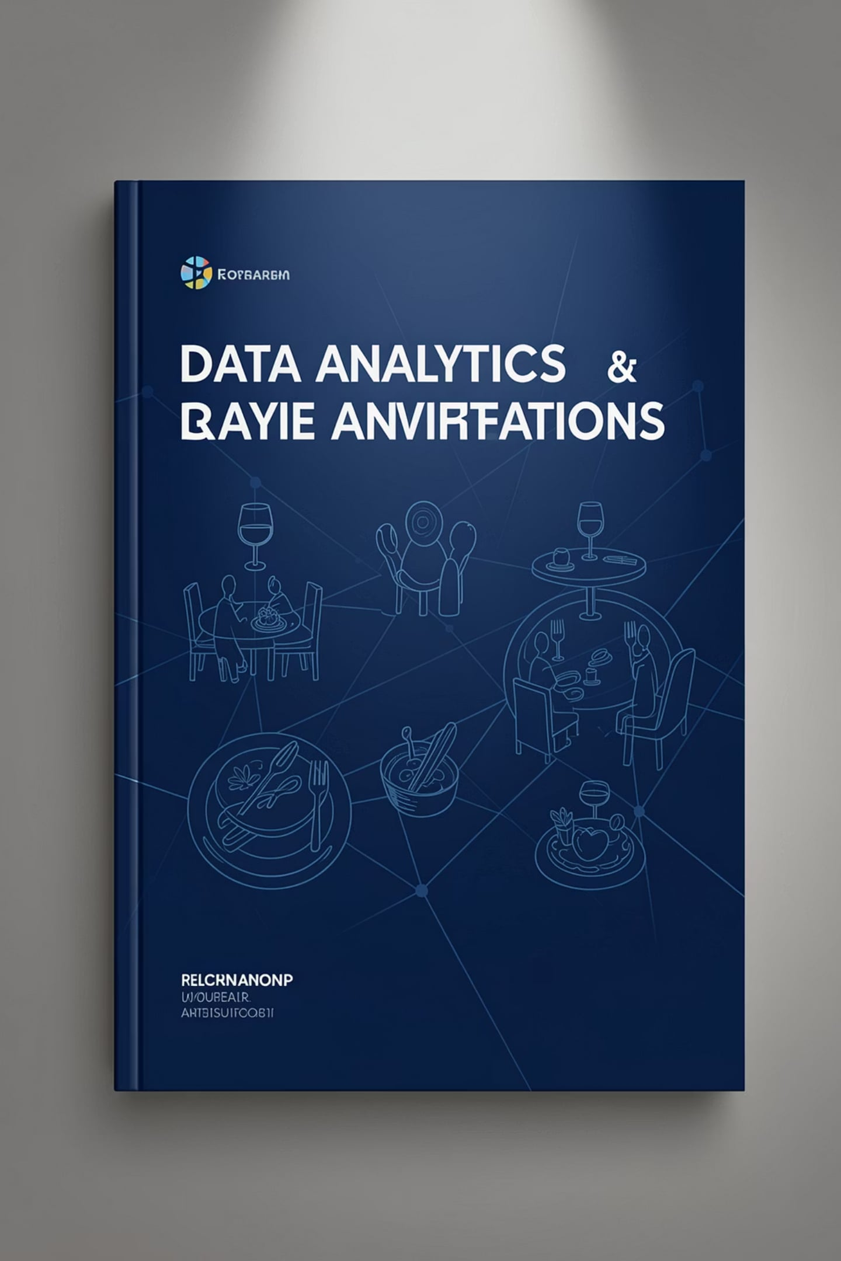
Restaurant Data Analysis Using Python
Python-based exploratory data analysis and business intelligence — Cognifyz Technologies (Data Analysis Internship)
Presented by Abhinav Kadam — Bachelor of Science in Data Science

Slide 2

Project Snapshot
This internship project applies Python to restaurant data to extract actionable business intelligence through cleaning, EDA, visualization, geographic mapping, sentiment processing and clustering.
Goal
Audience
Turn raw restaurant records into strategic recommendations for market expansion and service improvement.
Internship evaluators, faculty, and BI stakeholders.
Approach
Reproducible Python notebooks, visual storytelling, map-driven insights, and clustering for segmentation.

Slide 3
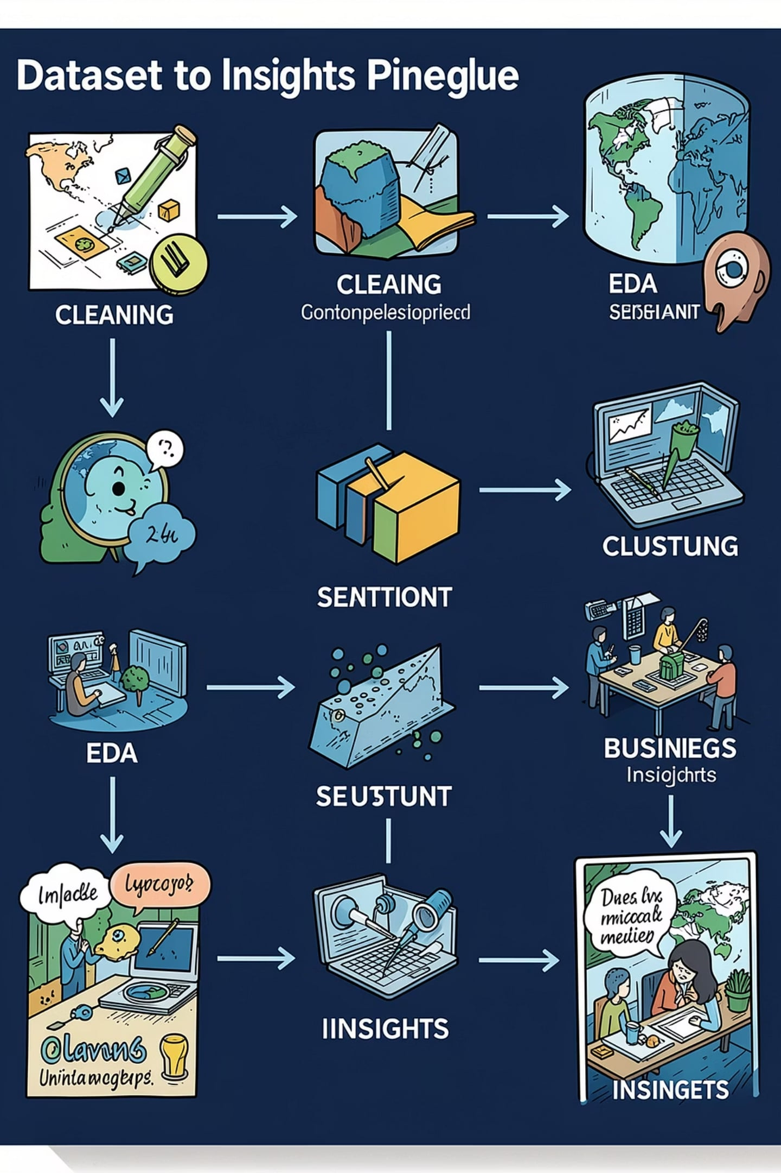

Project Overview
Workflow visualised: dataset → cleaning → exploratory analysis → layered analytics (Level 1–3) → business insights. Each stage refines data and increases actionability.
A compact workflow infographic emphasises iterative validation and inspection at each step.

Slide 4









Technology Stack
Python
Pandas & NumPy
Primary analysis language — reproducible notebooks.
Data wrangling, aggregation and numeric transforms.
Matplotlib / Seaborn
Plotly
Exploratory visualisation and statistical plots.
Interactive charts for stakeholder demos.
Folium
Scikit‑learn
Geographic visualisation with latitude/longitude overlays.
K‑Means clustering and basic model pipelines.
NLTK & WordCloud
Jupyter Notebook
Text pre-processing and visual sentiment summaries.
Exploration, documentation, and reproducible analysis.
Process Flow
Dataset
Cleaning
EDA
Level 1
Level 2
Flowchart highlights the layered analysis approach that increases depth and specificity of recommendations.

Slide 5
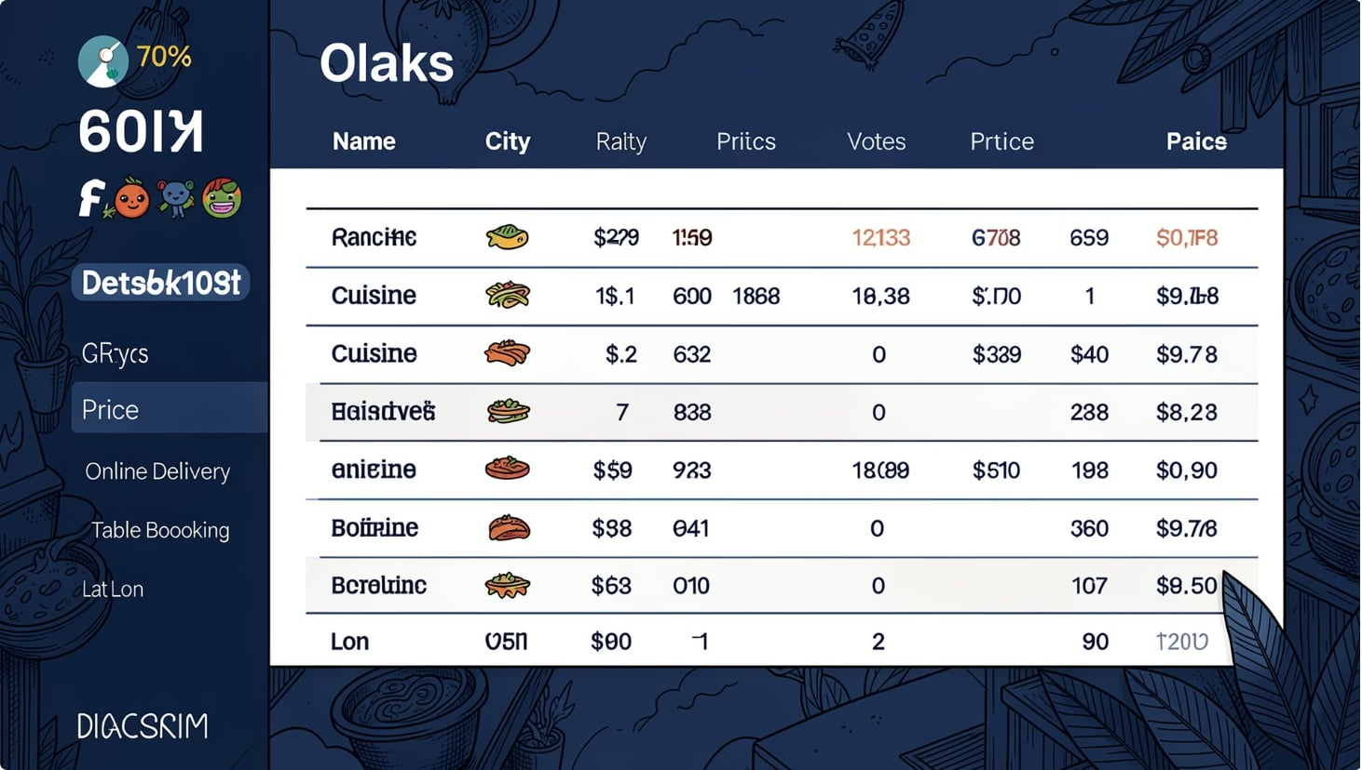
Data & Cleaning
Dataset fields
Restaurant name, City, Cuisine(s)
Rating, Votes, Price range
Online delivery, Table booking
Latitude & Longitude (geo mapping)
Cleaning steps
Missing values
Duplicates
Type validation
Standardisation
Imputed or flagged depending on impact (e.g., lat/lon required for maps).
De-duplicated by name + city + coordinates.
Ratings cast to float, votes to int, price ranges normalised.
Unified cuisine names and boolean flags for services.

Slide 6
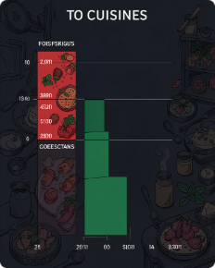
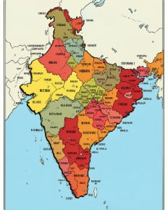
Level 1 — Descriptive Analysis
Core tasks: identify top cuisines, city distribution, price-range composition and online-delivery coverage.
Key findings
North Indian is the most frequent cuisine across dataset (highest share of listings).
New Delhi shows the largest concentration of restaurants in the sample.
Low-cost / budget price tiers dominate listing counts.
Online delivery available for a subset—useful for targeted partnerships.
Top cuisines
City distribution
Frequency-ranked; useful for menu focus and promotions.
Heatmap highlights urban hotspots for expansion.

Slide 7
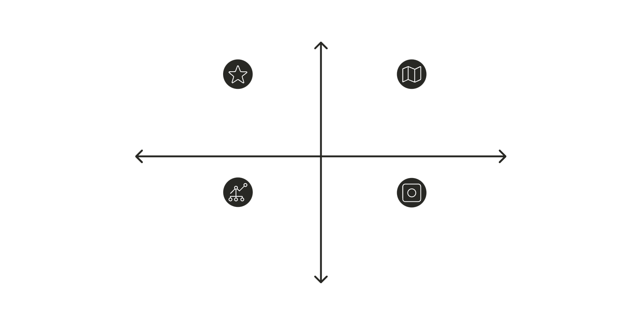

Level 2 — Segmentation & Geography
Completed tasks
High Ratings (4.0–4.5)
Rating analysis — distribution and outlier detection
Cuisine combination patterns — co-occurrence analysis
Geographic analysis — maps and density plots
Restaurant chains detection and market share
K‑Means clustering to segment locations by features
High Rating, Low Concentration
High Rating, High Concentration
Low Metro Density
High Metro Density
Low Rating, High Concentration
Low Rating, Low Concentration
Key findings
Low Ratings (3.0–3.9)
Majority of ratings fall between 3.0 and 4.5, suggesting moderate-to-good satisfaction.
Restaurants densely cluster in metropolitan corridors.
Chains exhibit clear geographic footprints — potential for standardisation strategies.
Layered analysis combining ratings, spatial density and unsupervised clustering to reveal operational patterns.
Maps and clusters support location strategy and resource allocation decisions.

Slide 8

Level 3 — Sentiment, Votes & Correlations
Analytical tasks
Sentiment analysis on review text (NLTK preprocessing, polarity scoring)
Votes analysis — relationship between votes and ratings
Correlation analysis — price range vs rating vs services (table booking, delivery)
Key findings
Overall customer sentiment skewed positive; common praise cites food quality and timeliness.
Higher-rated restaurants typically accumulate more votes — a proxy for engagement and visibility.
Premium price tiers more likely to offer table booking; service options correlate with higher ratings.

Slide 9
Business Insights & Recommendations
Market focus
Geographic expansion
Service improvements
Prioritise investment in North Indian and other top cuisines for menu optimisation and marketing.
Target underserved high-demand cities identified in maps for new openings or delivery partnerships.
Standardise table-booking and delivery workflows; training to improve service quality and ratings.
Digital strategy
Pricing & consistency
Enhance online presence and promotion where delivery take-up is low to increase reach and votes.
Use data-driven pricing and cross-branch consistency checks for chains to protect brand reputation.

Slide 10



Conclusion & Skills Demonstrated
Next steps: Prototype targeted campaigns for top cuisines, pilot expansion in two high‑demand cities, and implement A/B tests for digital promotions to measure vote and rating lift.
Thank you — questions?
Contact: Abhinav Kadam • GitHub: github.com/abhinanalyst
Project outcomes
Skills learned
Data cleaning, EDA, geographic mapping, sentiment analysis and K‑Means clustering — actionable insights produced.
Python, Pandas, NumPy, Matplotlib/Seaborn, Plotly, Folium, Scikit‑learn, NLTK, WordCloud, reproducible notebooks and GitHub workflows.

